Slide 1

Seminar
On
Smart Dust
Submitted To: Submitted By:
Mr Pawan Sen Shahnawaz Alam
HOD CSE VII SEM CSE
21EAICS148
Notes:
1
1

Slide 2
Content
Introduction
What is Smart Dust?
Smart Dust Mote
Architecture
Smart Dust Technology
Smart Dust Components
Communication with Smart Dust
Application
Challenges
Conclusion
Reference

Slide 3
Introduction
Smart dust is a tiny dust size device with extra-ordinary capabilities.
Smart dust combines sensing, computing, wireless communication capabilities and autonomous power supply within volume of only few millimeters and that too at low cost.
These devices are proposed to be so small and light in weight that they can remain suspended in the environment like an ordinary dust particle.

Slide 4
What is Smart Dust?
A tiny dust size device with extra-ordinary capabilities.
Often called micro electro-mechanical sensors
Combines sensing, computing, wireless communication capabilities and autonomous power supply within volume of only few millimeters.
Useful in monitoring real world phenomenon without disturbing the original process.

Slide 5
What is Smart Dust? (Cont..)
so small and light in weight that they can remain suspended in the environment like an ordinary dust particle.
the air currents can also move them in the direction of flow.
It is very hard to detect the presence of the Smart Dust and it is even harder to get rid of them once deployed.

Slide 6
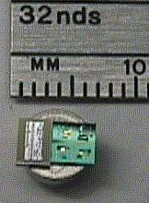
Smart Dust Mote

Slide 7
Architecture
A single Smart Dust mote has:
a semiconductor laser diode and MEMS beam steering mirror for active optical transmission
a MEMS corner cube retro-reflector for passive optical transmission
an optical receiver
a signal processing and control circuitry
a power source based on thick-film batteries and solar cells.

Slide 8
Smart Dust Technology
MEMS sensors
MEMS beam steering mirrors for optical transmission
MEMS corner cube retroreflector for passive optical transmission
An optical receiver
Signal processing and control circuitory
A power source based on thick film batteries and solar cells

Slide 9
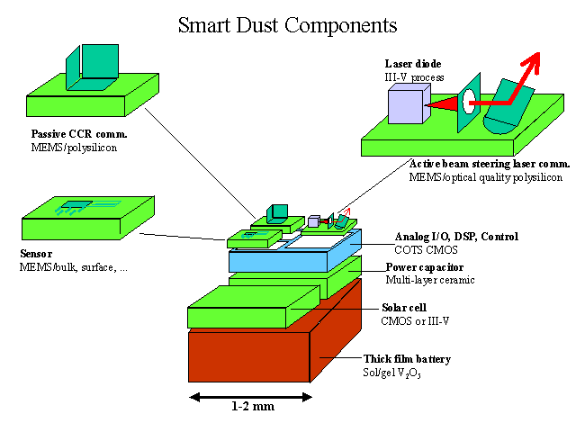

Slide 10
Communication with Smart Dust
Radio Frequency Transmission
Optical transmission technique
Passive Laser based Communication
Active Laser based Communication
Fiber Optic Communication

Slide 11
Application
Environmental protection (identification and monitoring of pollution).
Habitat monitoring (observing the behavior of the animals in there natural habitat).
Military application (monitoring activities in inaccessible areas, accompany soldiers and alert them to any poisons or dangerous biological substances in the air).
Indoor/Outdoor Environmental Monitoring.

Slide 12
Application
Security and Tracking
Health and Wellness Monitoring (enter human bodies and check for physiological problems).
Factory and Process Automation.
Seismic and Structural Monitoring.
Monitor traffic and redirecting it.

Slide 13
Challenges
To incorporate all these functions while maintaining a low power consumption
Maximising operating life given the limited volume of energy storage
The functionality can be achieved only if the total power consumption is limited to microwatt levels.
An unbroken line of sight of path should be available for free space optical links.

Slide 14
Conclusion
There are many ongoing researches on Smart Dust, the main purpose of these researches is to make Smart Dust mote as small as possible and to make it available at as low price as possible.
Soon we will see Smart Dust being used in varied application from all spans of life.

Slide 15
References
www.wikipedia.com
www.google.com

Slide 16
Thanks

